Slide 1
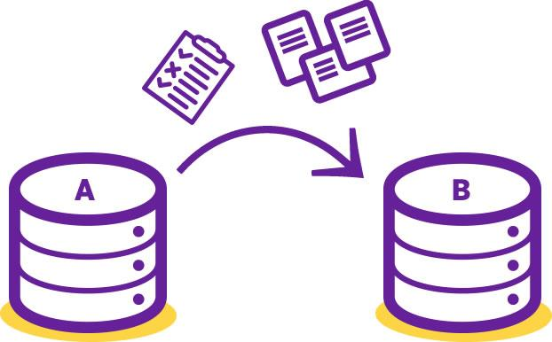

Drupal 8 Migrations
An Overview
Drupal North 2017

Slide 2

ABOUT THIS TEMPLATE
What’s this?
This is a free presentation template for Google Slides designed by SlidesCarnival.
We believe that good design serves to better communicate ideas, so we create free quality presentation templates for you to focus on the content.
Enjoy them at will and share with us your results at:
twitter.com/SlidesCarnival
facebook.com/slidescarnival
How can I use it?
Open this document in Google Slides (if you are at slidescarnival.com use the button below this presentation). You have to be signed in to your Google account
EDIT IN GOOGLE SLIDES Go to the File menu and select Make a copy. You will get a copy of this document on your Google Drive and will be able to edit, add or delete slides.
EDIT IN MICROSOFT POWERPOINT® Go to the File menu and select Download as Microsoft PowerPoint. You will get a .pptx file that you can edit in PowerPoint. Remember to download and install the fonts used in this presentation (you’ll find the links to the font files needed in the Presentation design slide)

Slide 3
Slides, code and Vagrant files:
https://github.com/sjpeters79/drupalcamp_migration
Reference Material:
https://github.com/open-data/od/tree/8.x-2.x/modules/custom/od_ext/od_ext_migration
Drupal Slack Group:
https://drupalslack.herokuapp.com/

Slide 4
Agenda
Migration Basics
Types of Migration
Migration Breakdown
Overview
Files Structure
Migration Structure
Drupal 7 to Drupal 8 Migration demo

Slide 5
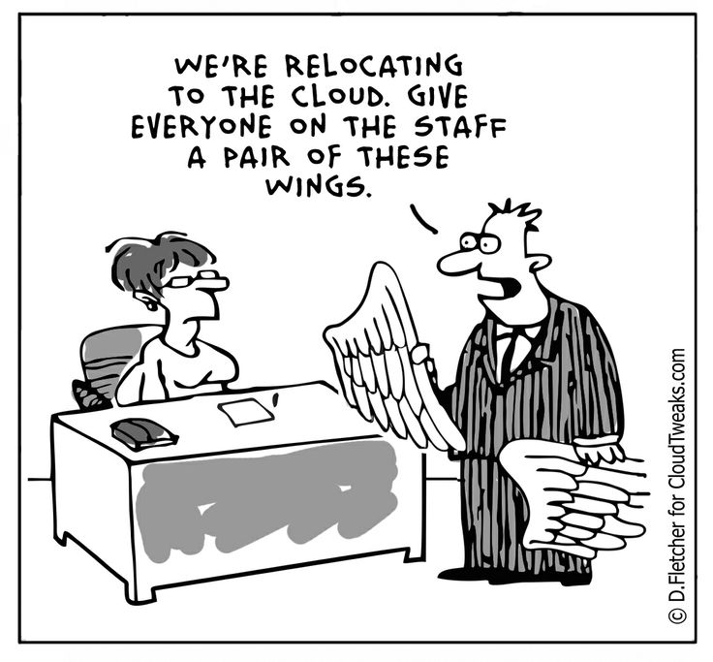
1.
Drupal Migrations Basics
Let’s dive in

Slide 6
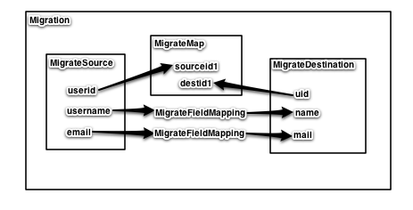
Migration Overview

Slide 7
What can you migrate
Content
Nodes, Taxonomy, Users, Blocks, menu links, etc
Configuration
Content types, site config, layouts, panels, views, etc.

Slide 8
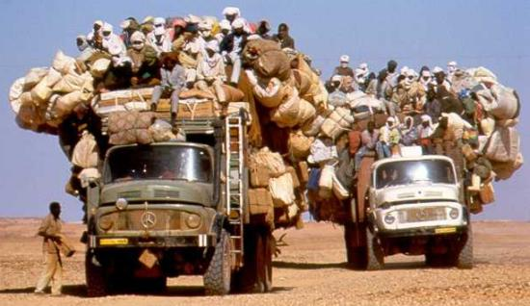
2.
Types of Migrations
Let’s dive in

Slide 9
Types of Migration
Manual Labour
Drupal to Drupal Migrations
Custom Drupal Migrations

Slide 10
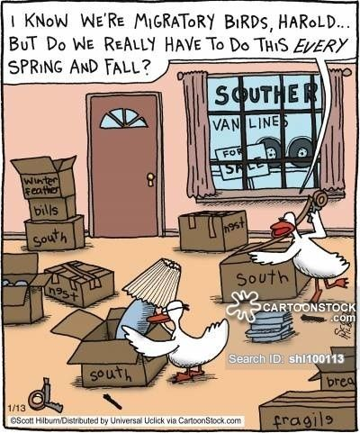
Manual Migrations
Slow and tedious
Allows for greater control
Great for small set of data

Slide 11
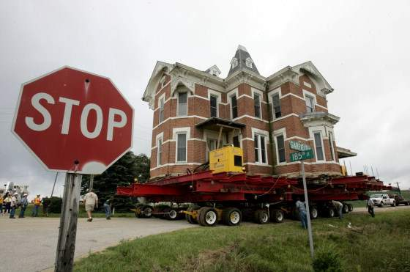
Drupal To Drupal Migration
Drupal upgrade path
Very easy
Doesn’t allow for refactoring of site structure
Can only migrate what is part of the source core
Ie will not migrate views since that’s not part of Drupal 6 or 7.

Slide 12
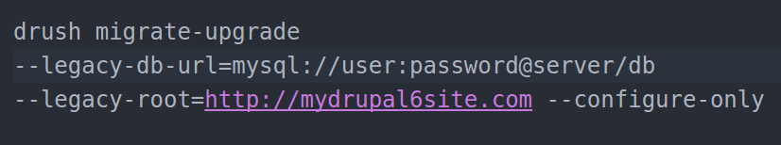
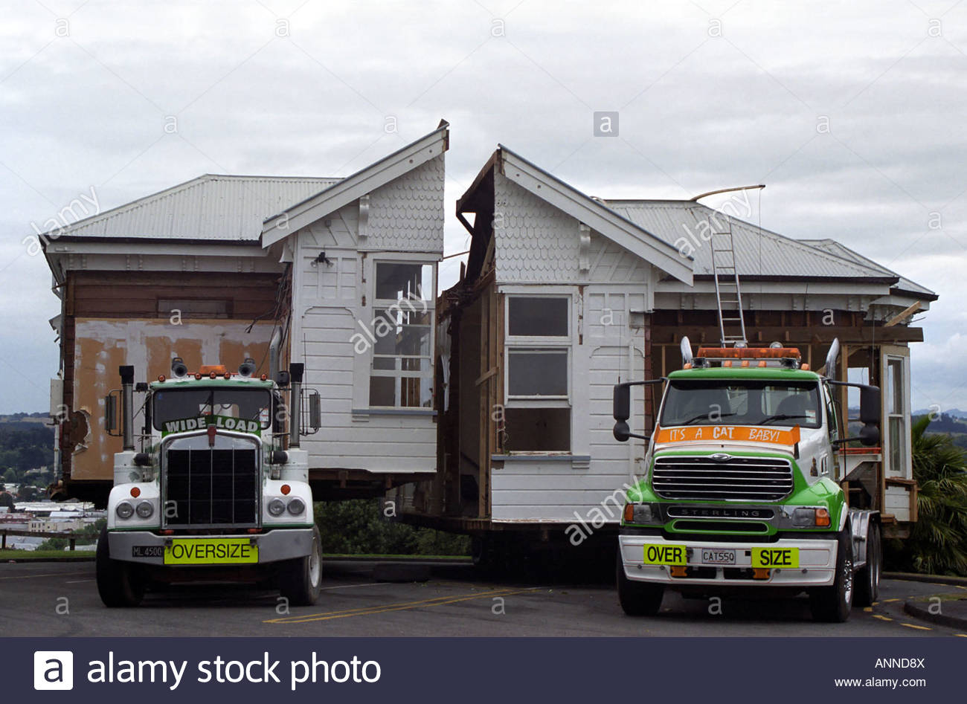
Partial Drupal To Drupal Migration
Allows for some refactoring

Slide 13

Custom Drupal Migrations
It’s completely customized
You migrate what you need and refactor along the way
Learn a lot about how Drupal 8 core works!!!
Requires a lot of time to learn
Requires a lot of patience

Slide 14
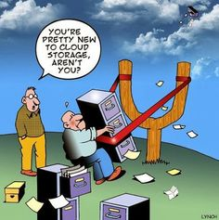
3.
Migration Breakdown
Let’s dive in

Slide 15
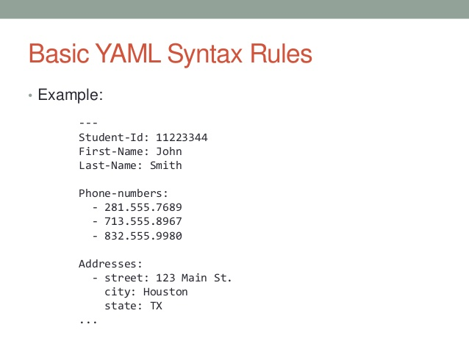
Drupal 8 Migrations Overview
YAML YAML YAML
Modules:
migrate (core)
migrate_tools (core)
migrate_plus (contrib)
migrate_ui

Slide 16
Files Structure
All yml migration files are stored under:
config/install/
All migration file names must start with:
migrate_plus.migration.{name}.yml
All source plugins are stored under:
src/Plugin/migrate/source

Slide 17
Files Structure
All process plugins are stored under:
src/Plugin/migrate/process
All destination plugins are stored under:
src/Plugin/migrate/destination

Slide 18
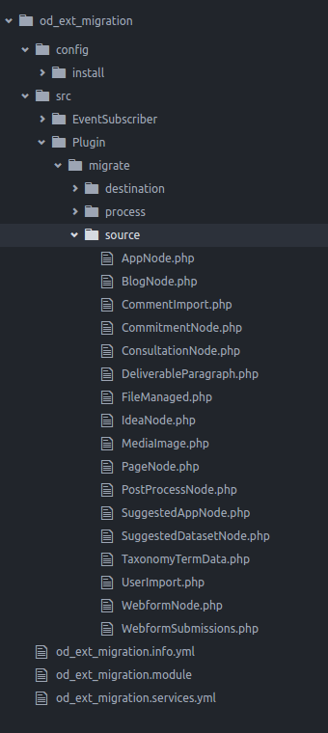
Files Structure

Slide 19
Migration YML Breakdown
Identifier
Source
Process
Destination
Dependencies
Plugins

Slide 20
id: dm_ext_db_node_article
migration_tags: null
migration_group: drupalcamp
dependencies:
enforced:
module:
- drupalcamp_migration
label: 'Database import for Commitment from legacy Drupal database'
source:
plugin: article_node
target: source_migration
Filename: migrate_plus.migration.dm_ext_db_node_article.yml
process:
title: title
type:
plugin: default_value
default_value: commitment
body/value: body
body/format:
plugin: default_value
default_value: rich_text
langcode: language
destination:
plugin: 'entity:node'
migration_dependencies:
required:
- dm_ext_db_user

Slide 21
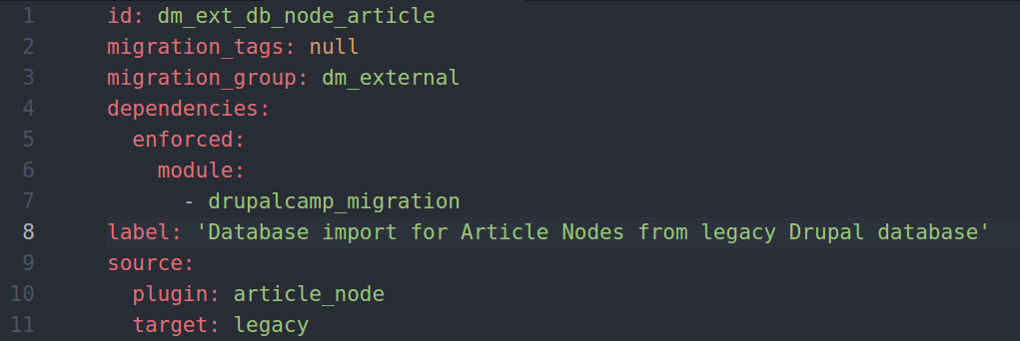
Identifier and Source Section
Filename: migrate_plus.migration.dm_ext_db_node_article.yml

Slide 22
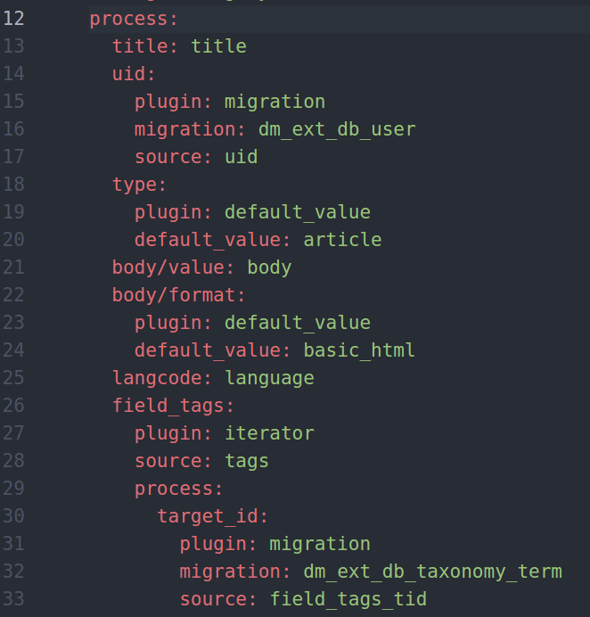
Process and Mapping Section
Filename: migrate_plus.migration.dm_ext_db_node_article.yml

Slide 23
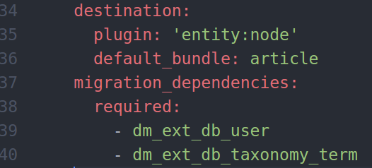
Destination & Dependencies
Filename: migrate_plus.migration.dm_ext_db_node_article.yml
Destination Plugin Examples:
entity:comment
entity:file
entity:media
entity:node
entity:user
entity:taxonomy_term
entity:block_content
entity_reference_revisions:paragraph
entity:group

Slide 24
The Migration Source can be:
Embedded data
SQL source
File based (JSON, CSV, XML, etc)

Slide 25
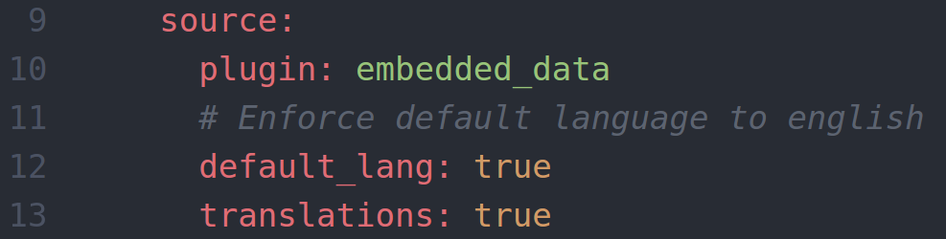
Embedded Data Example

Slide 26
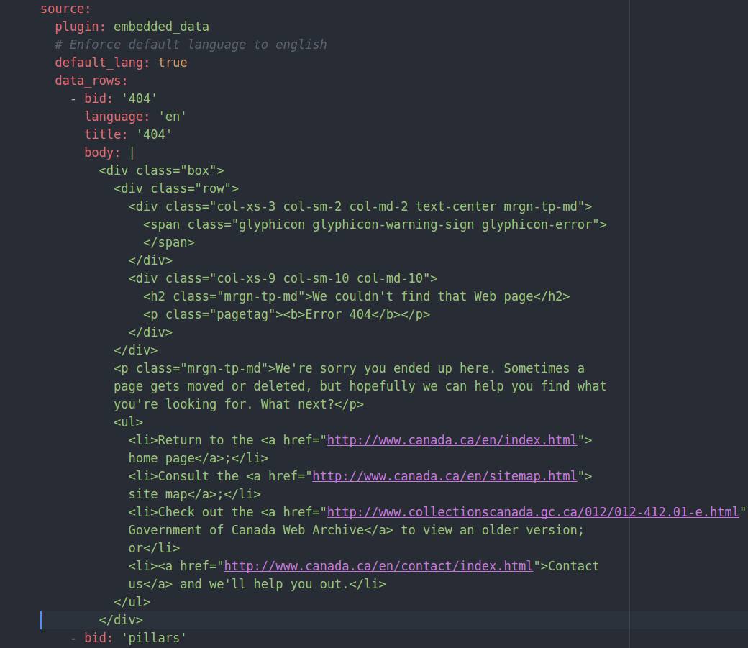
Embedded Data Example

Slide 27
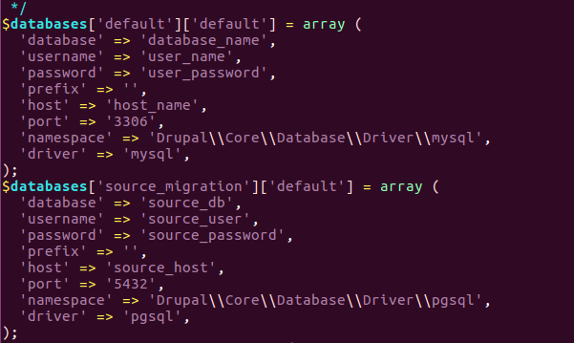
SQL Source Example
source:
plugin: user_import ← plugin_id
target: source_migration ← DB Connection
Filename: sites/default/settings.php

Slide 28
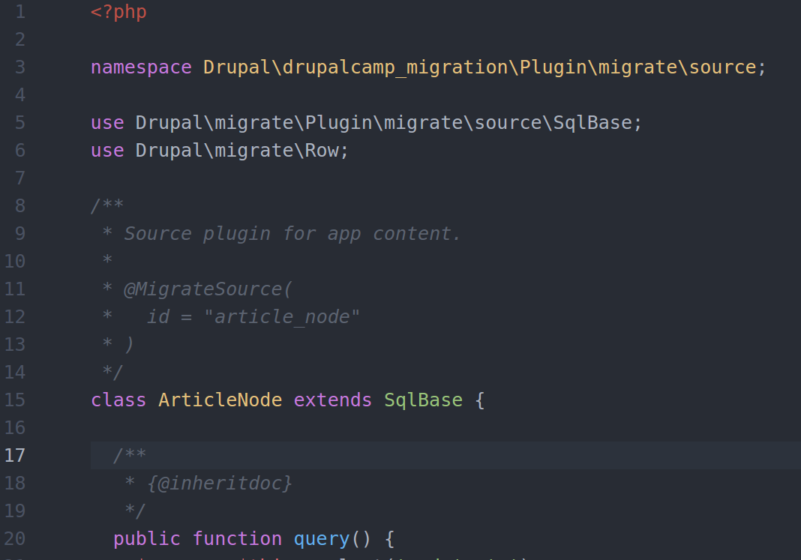
SQL Source Plugin Example
Filename: src/Plugin/migrate/source/ArticleNode.php
Must be the same

Slide 29
File Based (CSV, JSON, ETC.)
Drupal Migrate CSV: https://www.drupal.org/project/migrate_source_csv
JSON Parser:
https://www.drupal.org/project/migrate_plus

Slide 30
Migration YML Breakdown
Identifier
Source
Process
Destination
Dependencies
Plugins

Slide 31
Process Section
Contains all source and destination mapping.
Mappings are done in key: value pairing
Values can be transformed using process plugins

Slide 32
Process Examples
Each mapping can be:
Key: value mapping
Ie:
field_title: title
field_organization/value: org_name
field_url/uri: url

Slide 33
Process Examples
Or it can be a:
key: associative array
type:
plugin: default_value
default_value: article
field_url/title:
plugin: default_value
default_value: ‘Hello World’

Slide 34
Process Examples
uid:
plugin: migration
migration: ext_db_user
source: uid

Slide 35
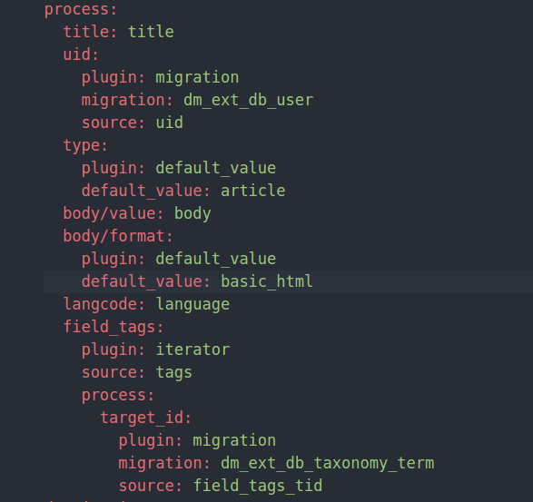
Process Examples

Slide 36
Migration YML Breakdown
Identifier
Source
Process
Destination
Dependencies
Plugins

Slide 37
Destination Plugins
Destination has a mandatory plugin key that must be set to an entity or configuration within your drupal 8 site.
Destination can have an optional key of default_bundle: <type>

Slide 38
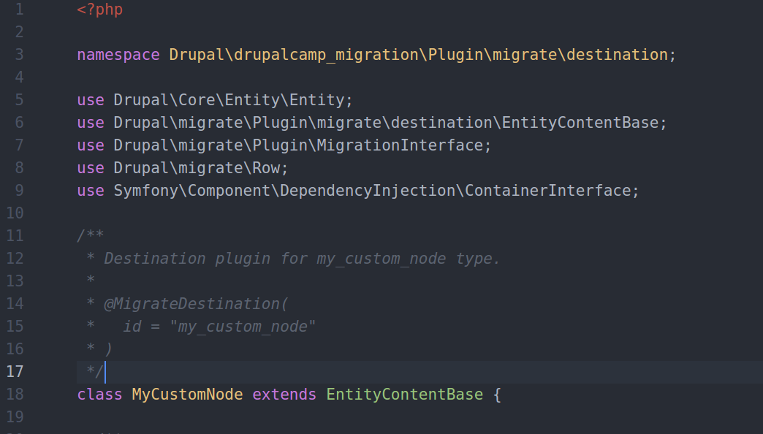
Destination Example
Filename: src/Plugin/migrate/destination/MyCustomNode.php

Slide 39
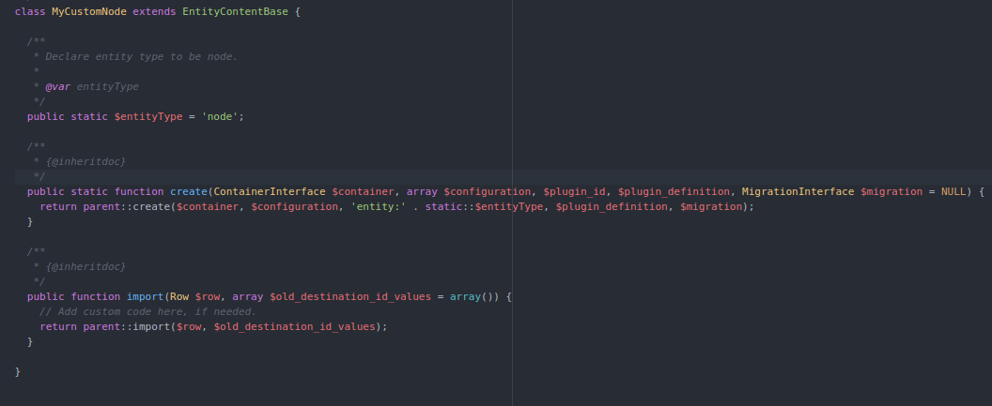
Destination Example
Filename: src/Plugin/migrate/destination/MyCustomNode.php

Slide 40

Demo Time
Let’s dive into some YML config and php code

Slide 41

Yeah we’re done. Any questions?

